Slide 1

Parenting the Teenage Brain:
Understanding Behavior. Reducing Stress. Building Resilience.
Stacy Ladden, Psy.D., BCBA-D, LBA

Slide 2
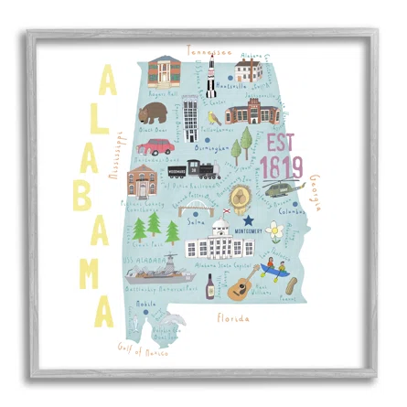

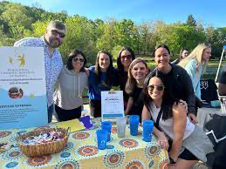
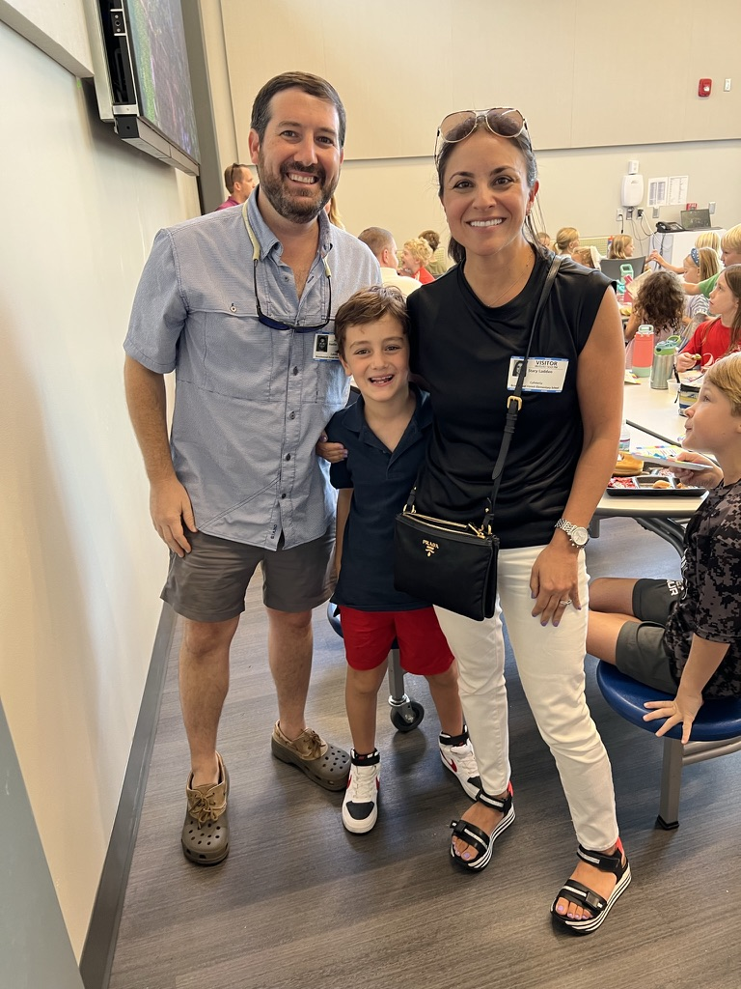
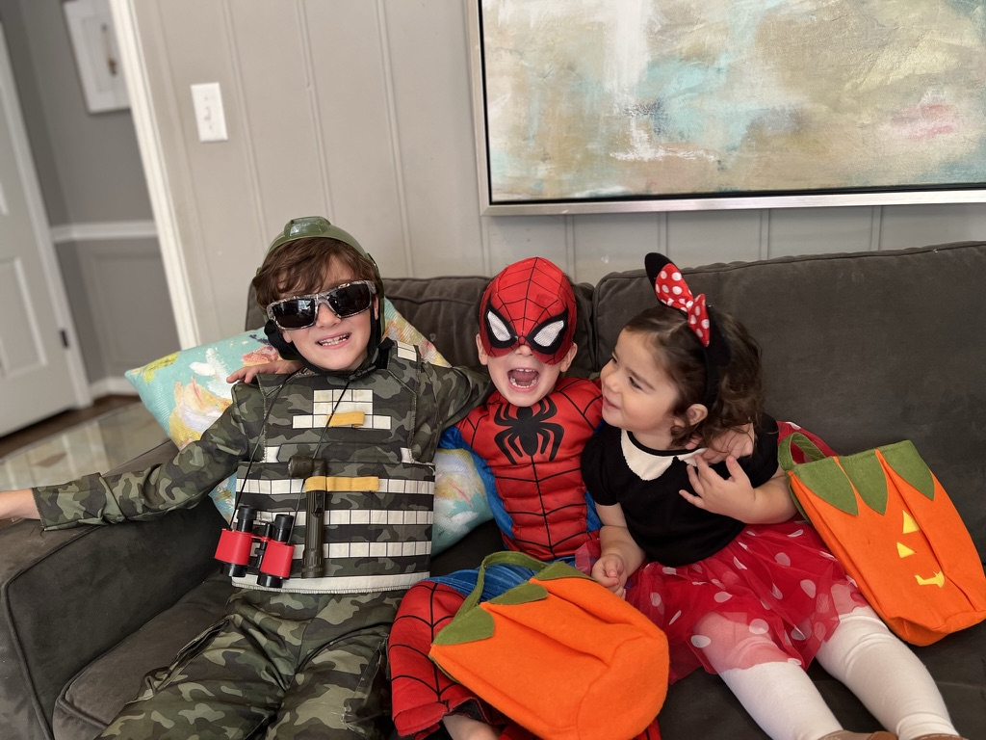
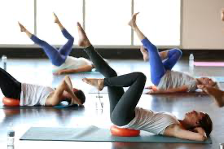

About Me

Slide 3
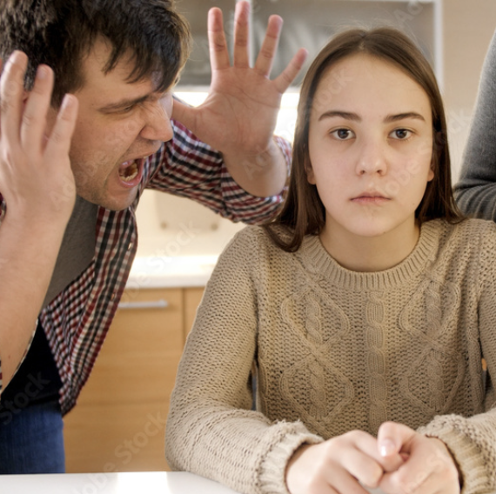
Have you ever thought…
Why is my teen so reactive?
Why don’t they think things through?
I am tired of walking on eggshells.
You are not failing…This is partially due to the adolescent brain.

Slide 4
Objectives
Understand the teen brain and development.
Decode behavior.
Reduce stress and power struggles.
Build resiliency using the 7 Cs: competence, confidence, connection, character, contribution, coping, and control.

Slide 5

Quick Reflection
What is the biggest challenge with your child/teen right now?

Slide 6
The Teen Brain= Under Construction
Emotional brain: Fully active
Thinking brain: Still developing
Big feelings + slower decisions

Slide 7
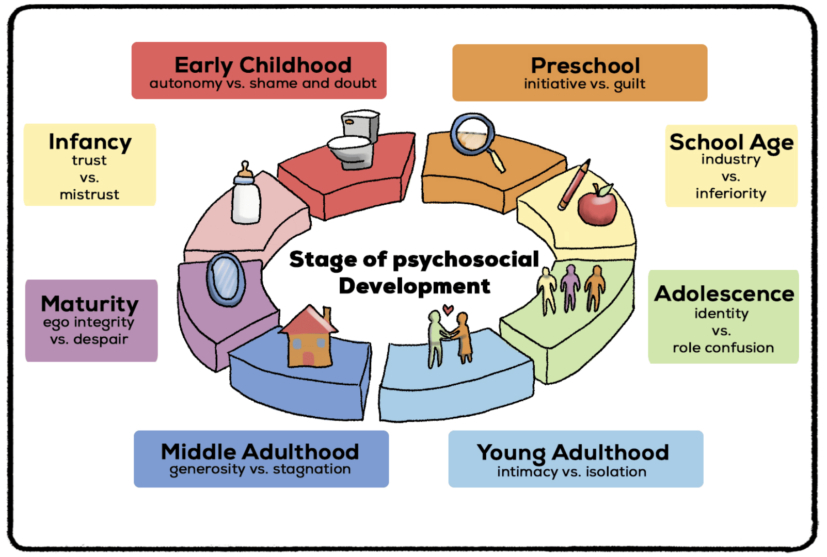
Developmental Stages of Adolescents
Early Adolescence (10–13): concrete/black-and-white thinking, emotional mood swings, egocentric, self-conscious, hyper focus on self, push boundaries and test limits.
Middle Adolescence (14–17): identity seeking, increased peer pressure, peer-driven, struggle with complex decision making, impulse control, and being able to consider options and consequences.
Late Adolescence (18–21): improved impulse control, assess risks (e.g., "While I want to go shopping, I need to study for my final.” ), independence, identity, and authority.

Slide 8
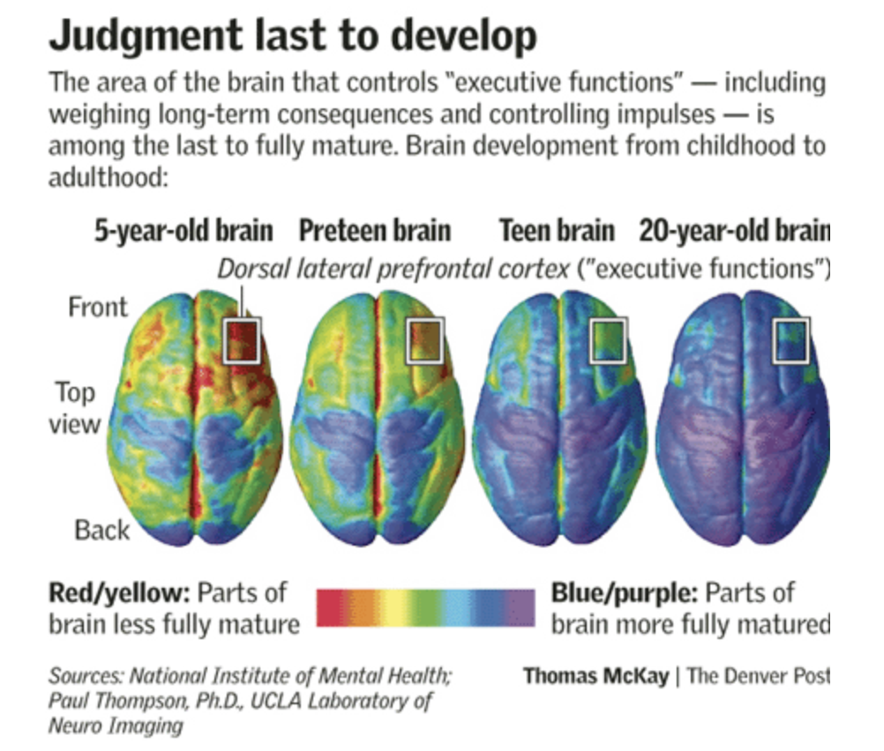
The Adolescent Brain

Slide 9
Quick Reflection
What one word would you use to describe what you were like as a teenager?

Slide 10
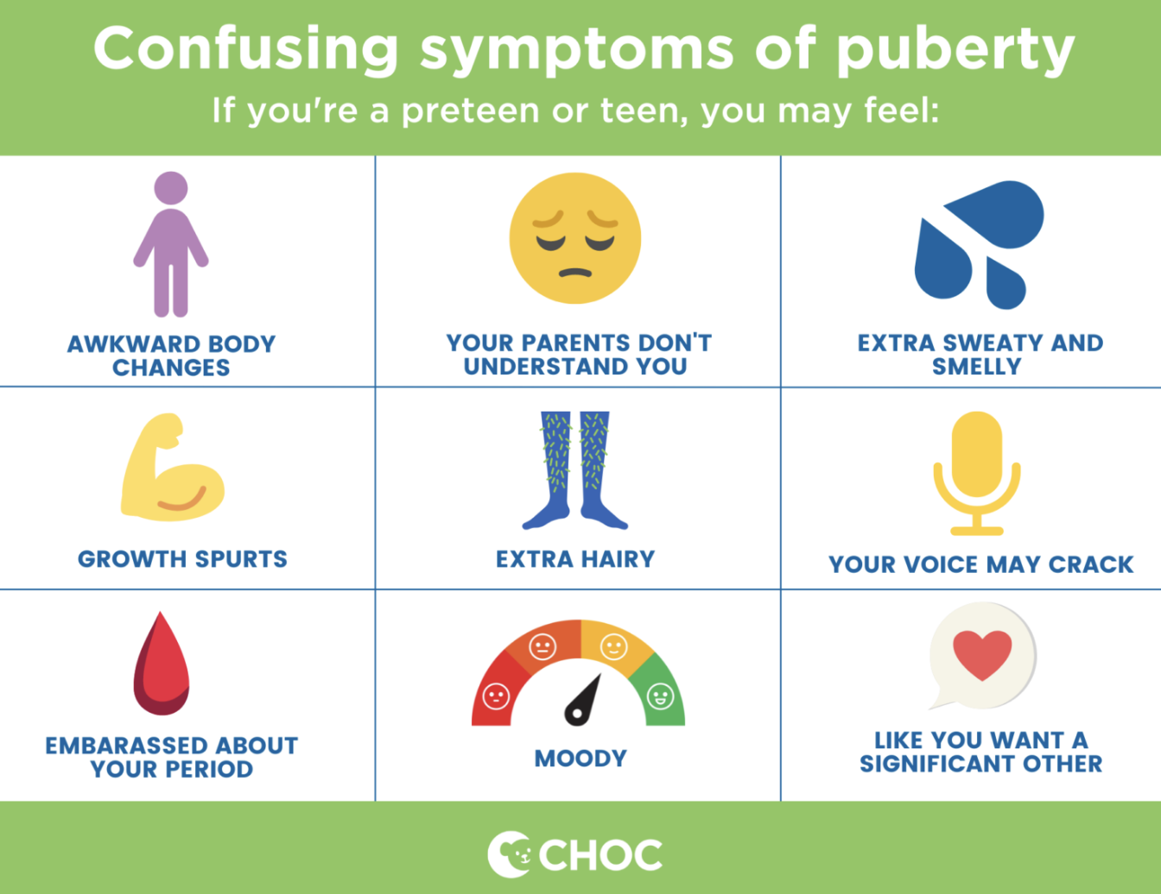
Adolescence = Rapid Change
Change creates stress.

Slide 11
Stressors in Adolescence
Constant comparison.
Fear of missing out.
Fear of judgment.

Slide 12
Why Teens Take Risks
Seek rewards over consequences.
Peer influence is powerful.
Stress amplifies reactions.

Slide 13
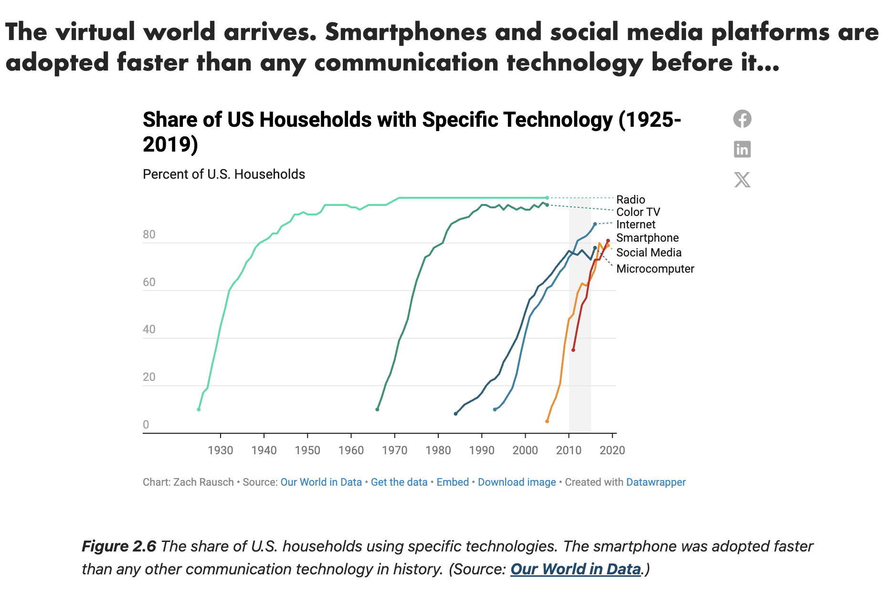
Teens + Social Media

Slide 14
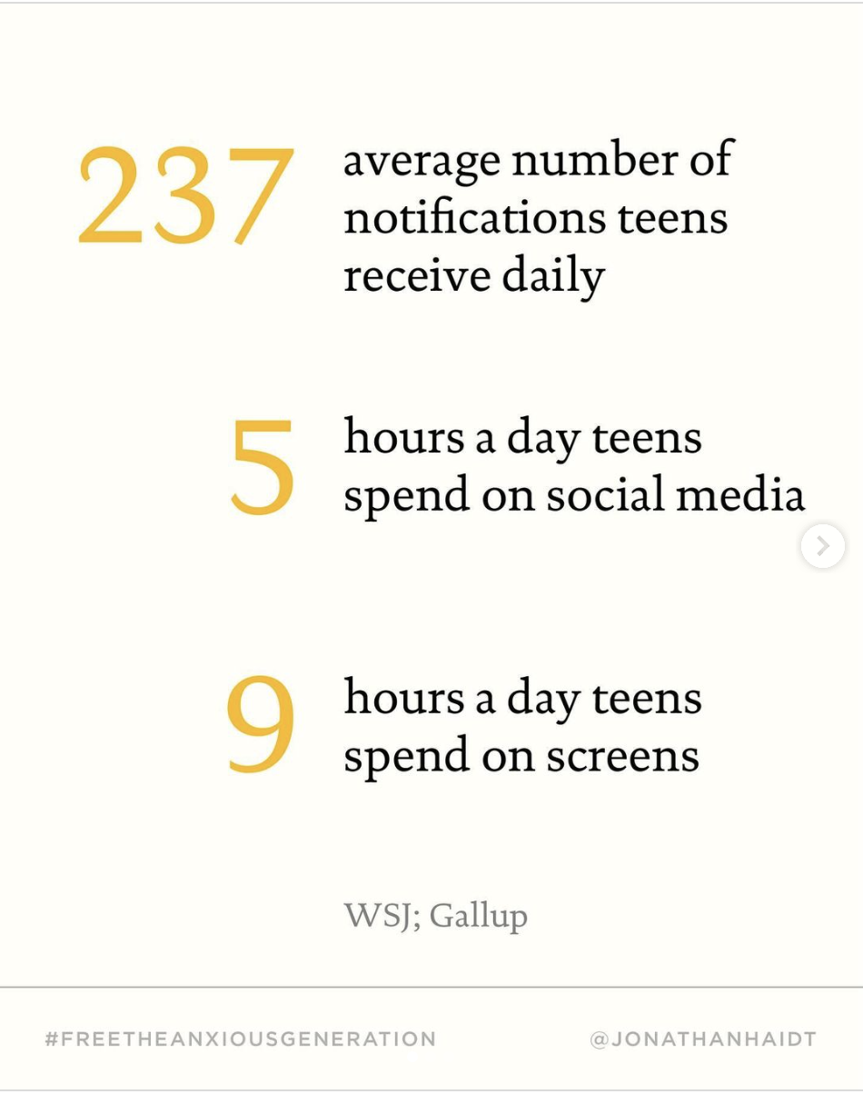
How many hours does the average teen spend on social media?

Slide 15
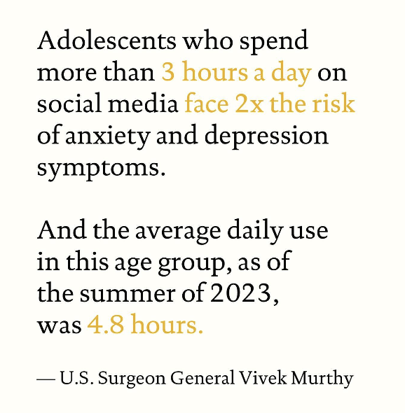
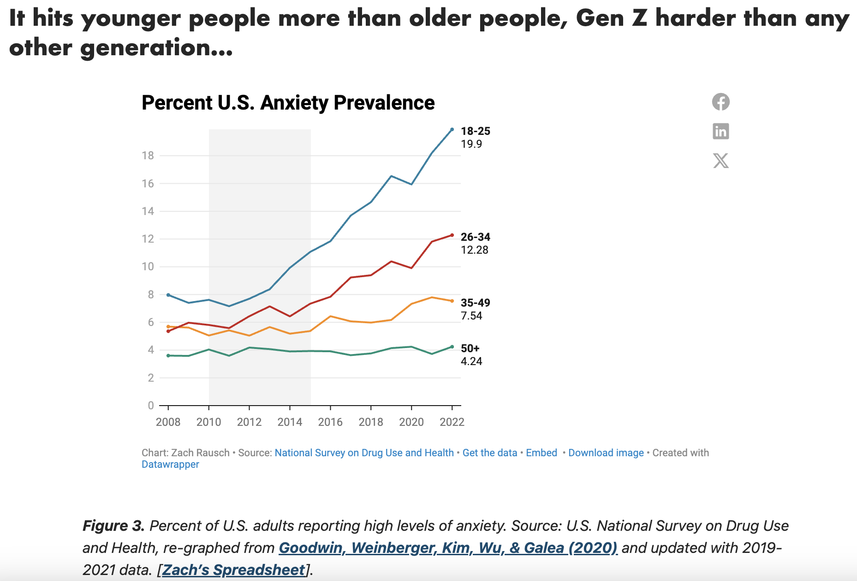
Teens + Social Media

Slide 16
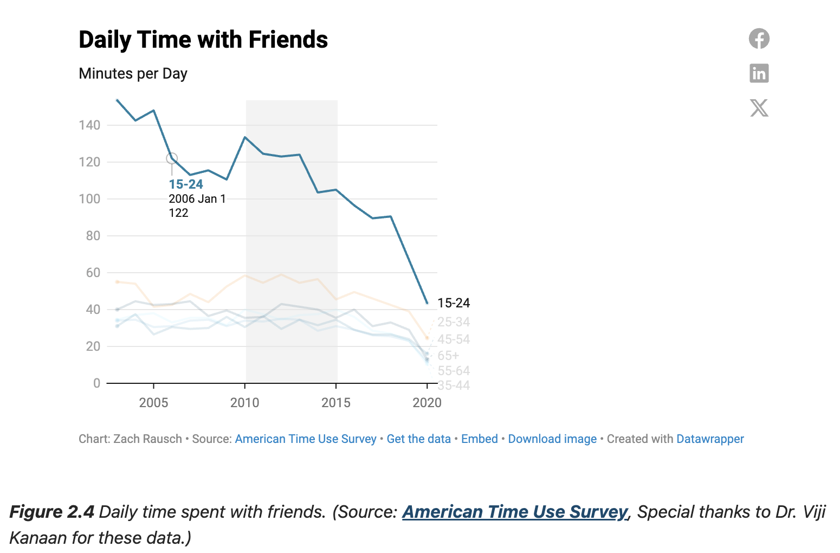
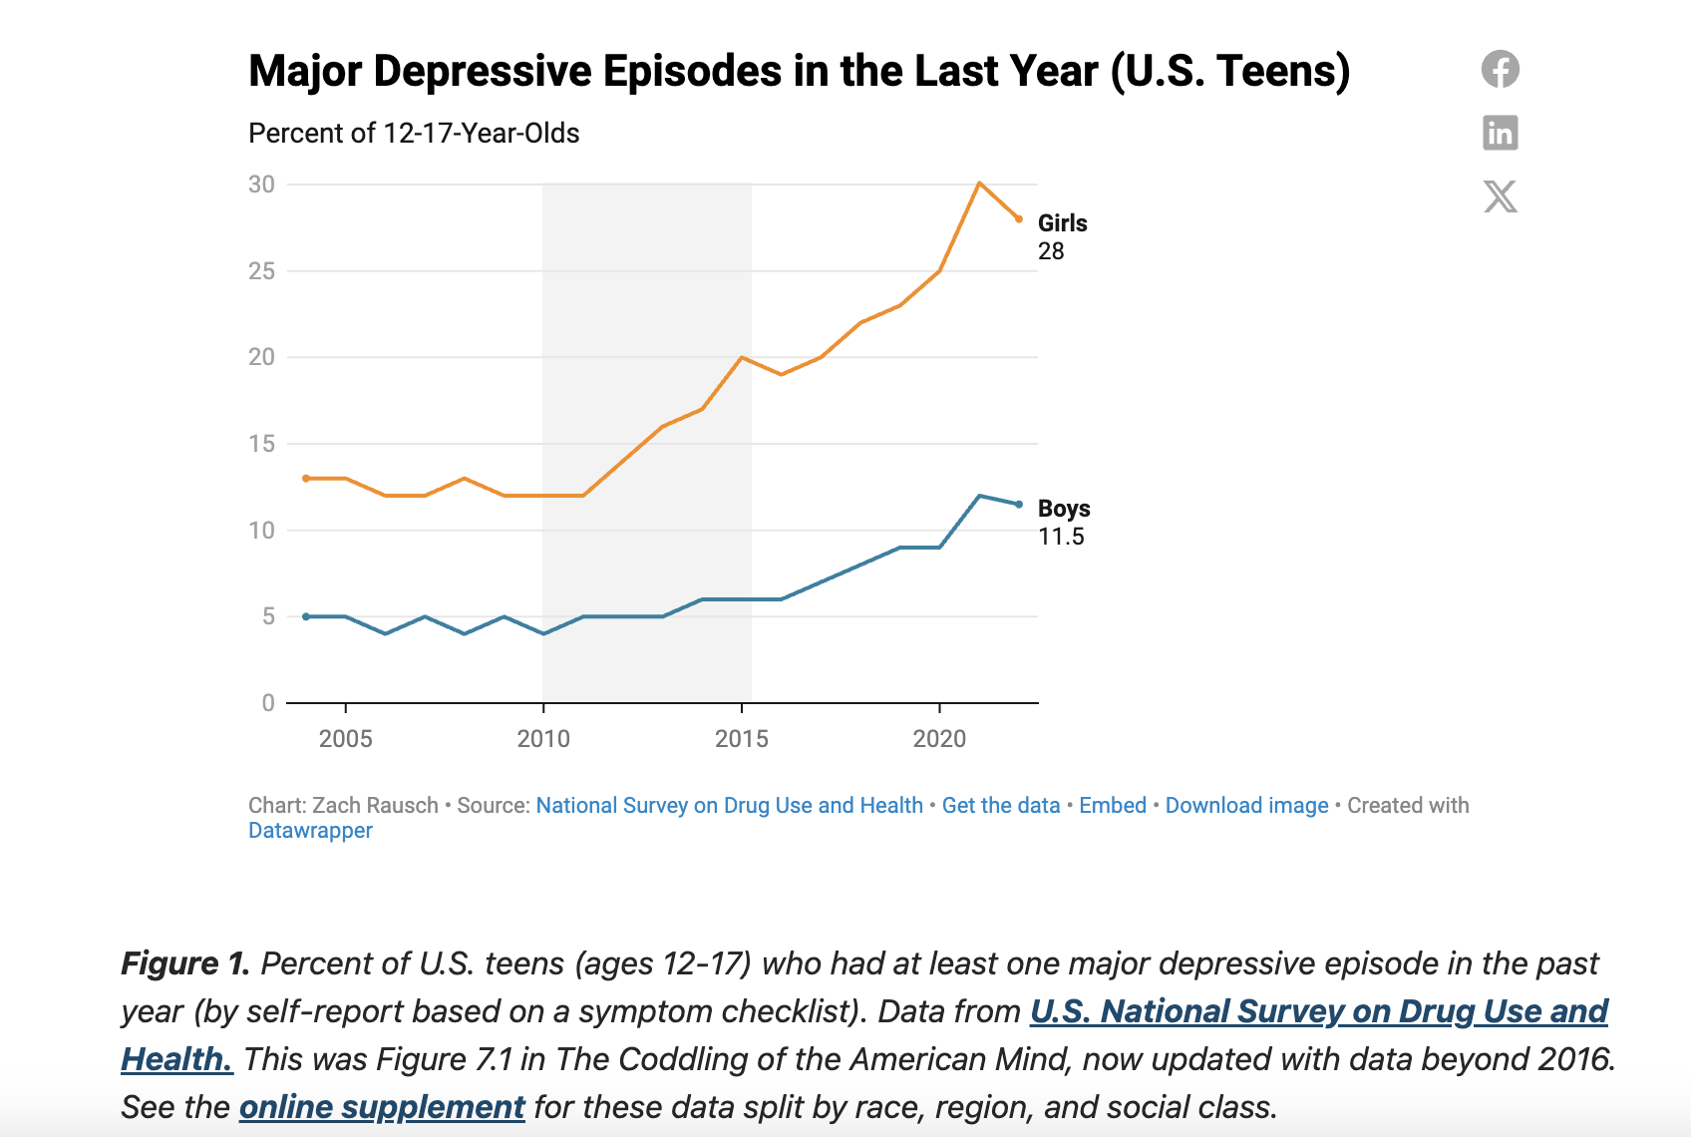
Teens + Social Media

Slide 17
Reflection
Raise your hand if…
Your teen checks their phone constantly.
You’ve had a conflict about screen time.

Slide 18
Problem Behavior vs. Unskilled Behavior
When people are wrong and make mistakes, we shame them.
“You need to be different, so I can feel better."
“This needs to be different, so I can feel better.”

Slide 19
Behavior is Communication
Defiance → Skills deficit
Laziness → Overwhelm
Disrespectful → Dysregulation

Slide 20
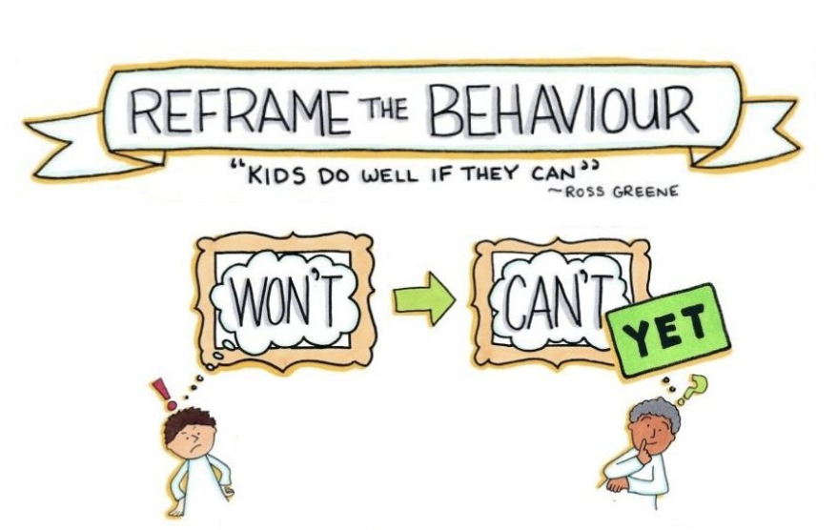
Reframe Practice
Think of your teen’s recent behavior.
👉 What might your teen be struggling with underneath?

Slide 21


Reframing Behavior
We all make mistakes.
“No matter what you do, I will show up as my best self for you.”

Slide 22

Resiliency
Connection gives motivation for conflict resolution.
Understanding the teen brain distances us from shame and guilt and shifts us to disciple or teach skills.
The goal becomes problem solving that aligns with a family’s morals and values (i.e., “I am going to get help.” “It sounds like you could use some help.”).
Resilience isn’t built through control… It’s built through connection and skill.

Slide 23
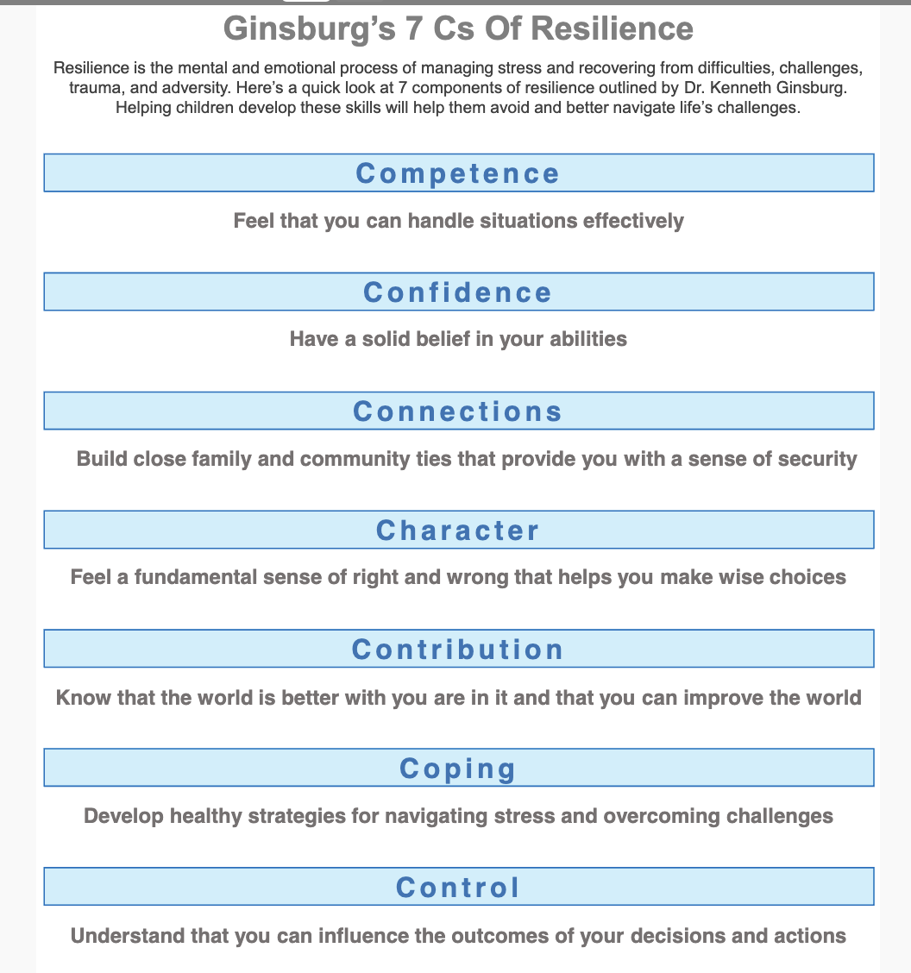

Slide 24

Connection
Connection- a relationship is a consequence of connection
Human connection is the most protective force in a teen’s life.
Connection First. Correction Second.

Slide 25
Connection
Family
Caring Adults
Schools
After-School Programs
Communities
Faith-Based Organizations

Slide 26
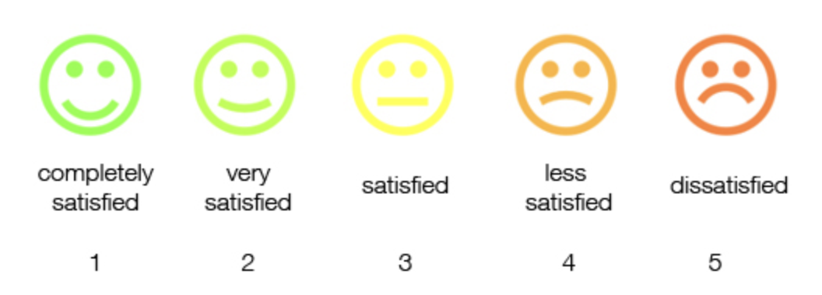
Reflection
Connection Check
On a scale of 1–5: 👉 How connected do you feel to your teen right now?

Slide 27
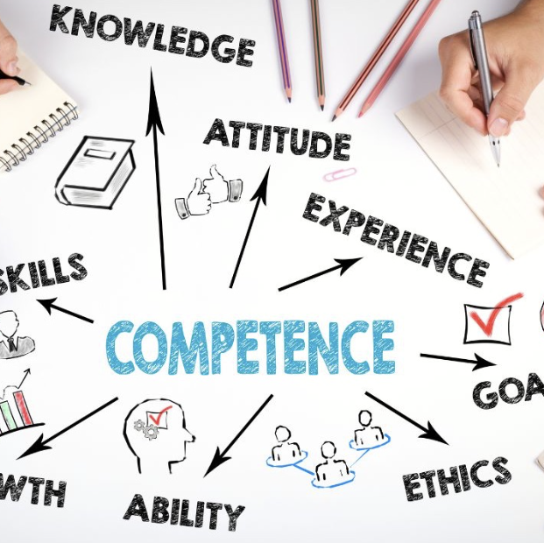
Competence: Building “I can” Thinking
“I know you can __________ because you have already shown me how you _____________.”
“I am on your team. We will figure this out together.”
“Do you need a solution or support?”
“It’s time for….What would be helpful?”

Slide 28
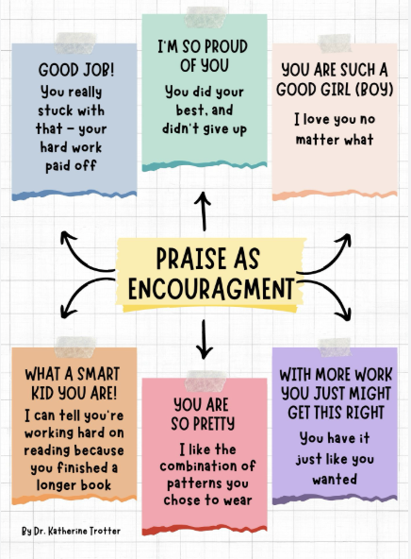
Confidence
Praise celebrates the moment.
Encouragement builds confidence that lasts.
Confidence grows from experience. Let them struggle.
Celebrate effort, not perfection.

Slide 29
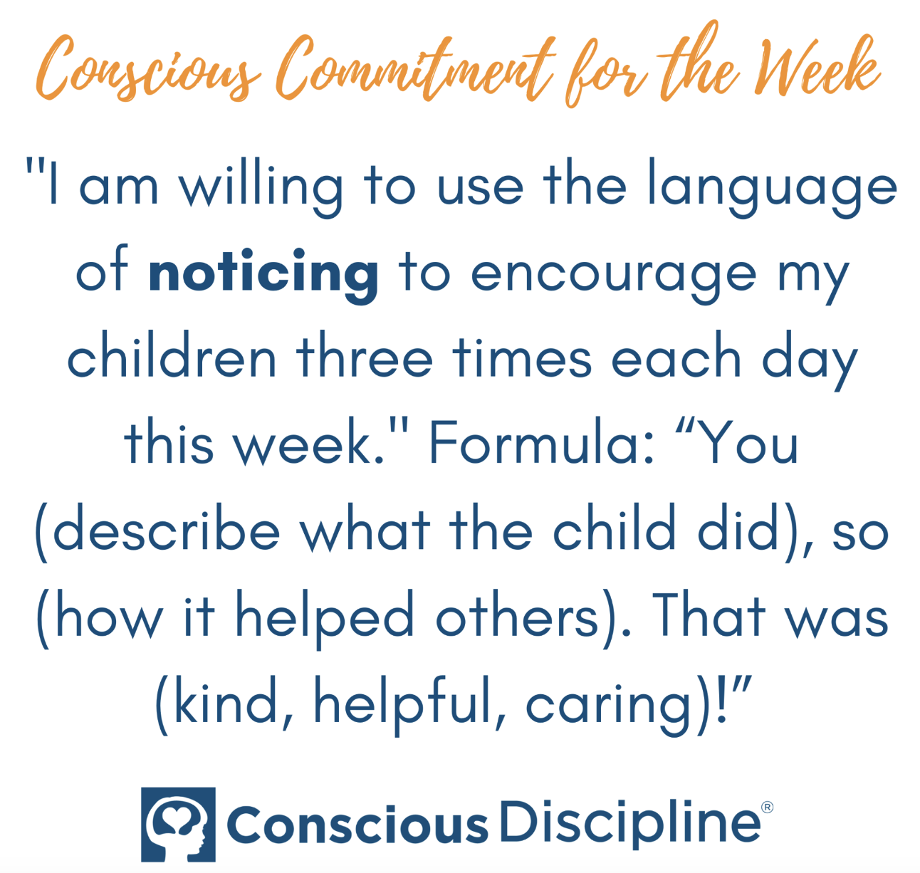
Noticing:
Being in the Present
Being present and providing non-judgmental feedback.
Ex: “ You put your plate in the sink so I knew you were finished. That was so helpful.”
Observing and describing a child’s nonverbal actions in a non-judgmental manner.
Noticing is a "you" statement versus an "I" statement.

Slide 30
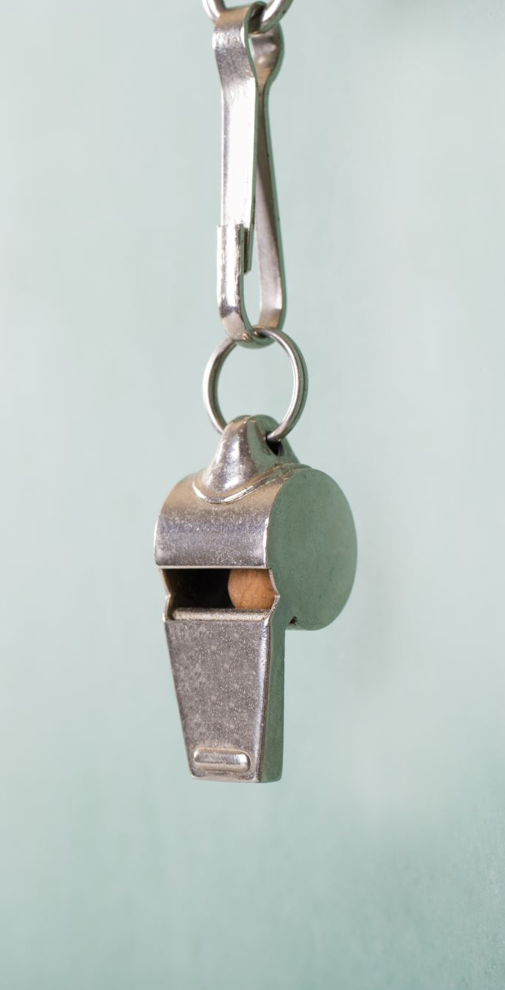
Control
Control- the power to direct others’ behaviors
Discipline is to cause someone to acquire knowledge or a skill.
Synonyms include to teach, instruct, educate, train, and school.
Discipline is about shifting from control to teaching self-control. It is about not punishing.

Slide 31
Boundaries
Boundary- something you tell someone you will do and it requires nothing of the other person.
Setting Effective Boundaries:
“It is my job to keep you safe and it is your job to help me keep you safe.”
Set consistent limits.
Be clear and specific.
Clearly state any exceptions you may have.
Provide reminders of consequences of actions.

Slide 32

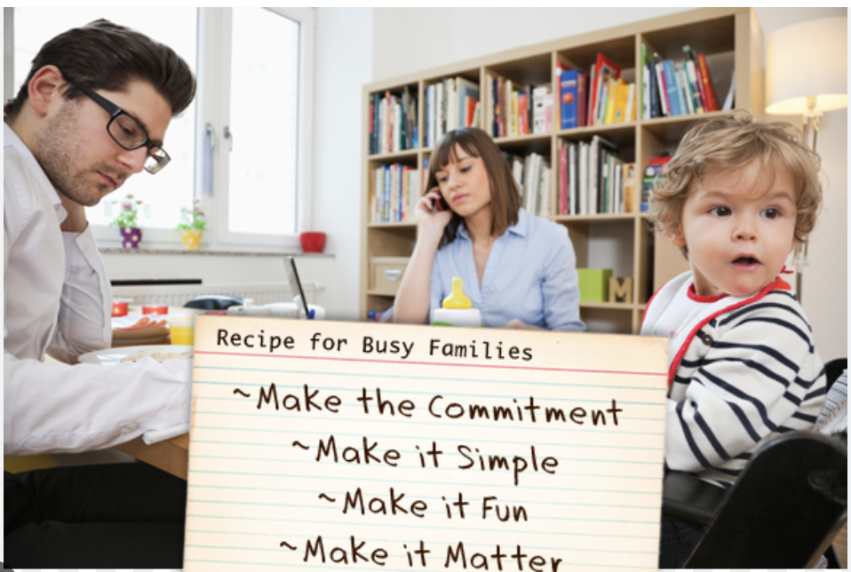
Structure Builds Safety
Rules- enforced and have consequences; non-negotiables
Agreements- shared expectations or guidelines for acceptable behavior within a group
Commitments- promises to oneself based on one’s morals and values
Routines- create consistency and predictability

Slide 33
Character
Teach values, integrity, respect, and honesty.
Recognize persistence and effort rather than the result.
Celebrate strengths.
Emphasize empathy by validating emotions and practice perspective taking.
Promote responsibility.
Who they are becoming matters most.

Slide 34
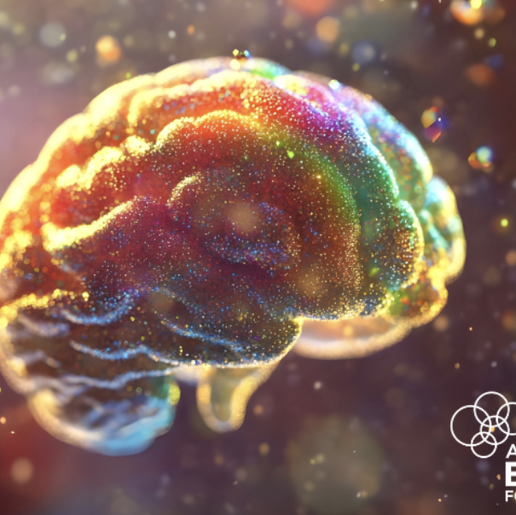
Contribution
  Kids thrive when they contribute:
  Acts of kindness.
  Gratitude.
  Helping others builds purpose.
  Multiple studies have found that teens who volunteer an hour or more a week are less likely to abuse drugs and alcohol.

Slide 35
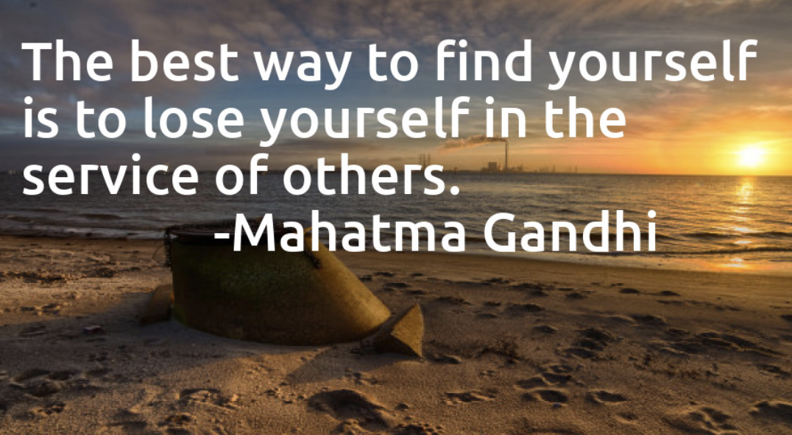
Contribution

Slide 36
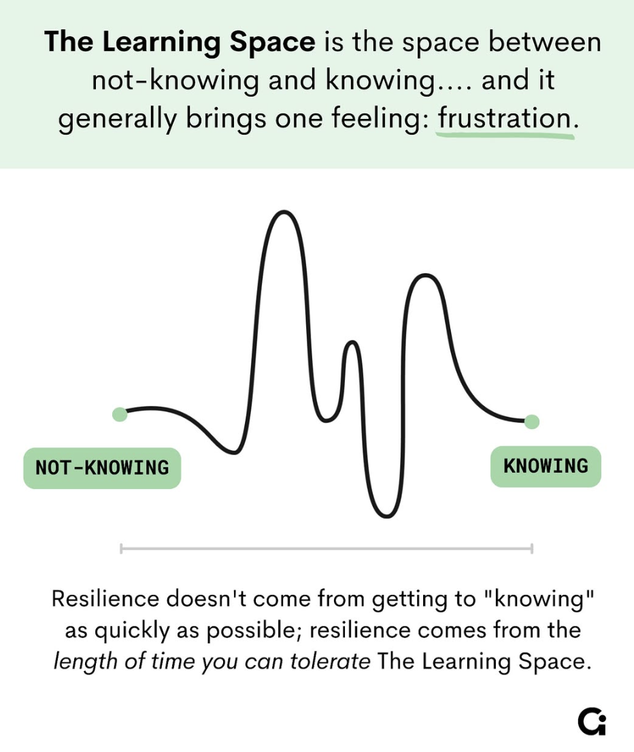
Coping
Coping- solving difficult problems to minimize or tolerate stress
  Stress is an uncomfortable part of life.
  Teaching children how to cope helps them to overcome life’s challenges.
  Risk-taking behaviors exist to alleviate stress.
  Problem behaviors → Unskilled behaviors

Slide 37
Coping
Exercise
Nutrition
Sleep
Express emotions
Seek help when needed
Problem-solve

Slide 38
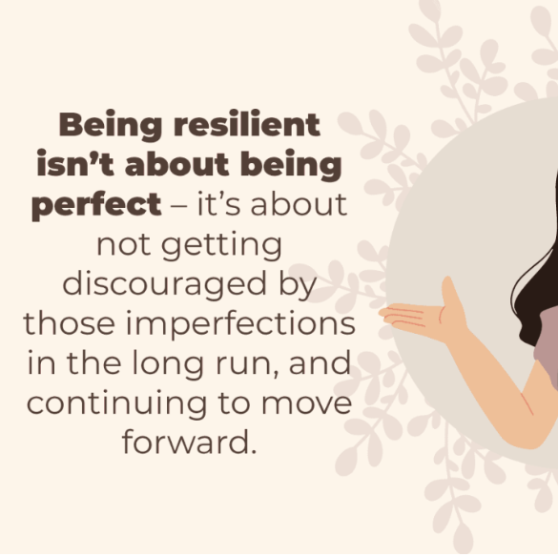
Resiliency
Learning to take responsibility for decisions, managing the consequences of choices, and building personal power.

Slide 39
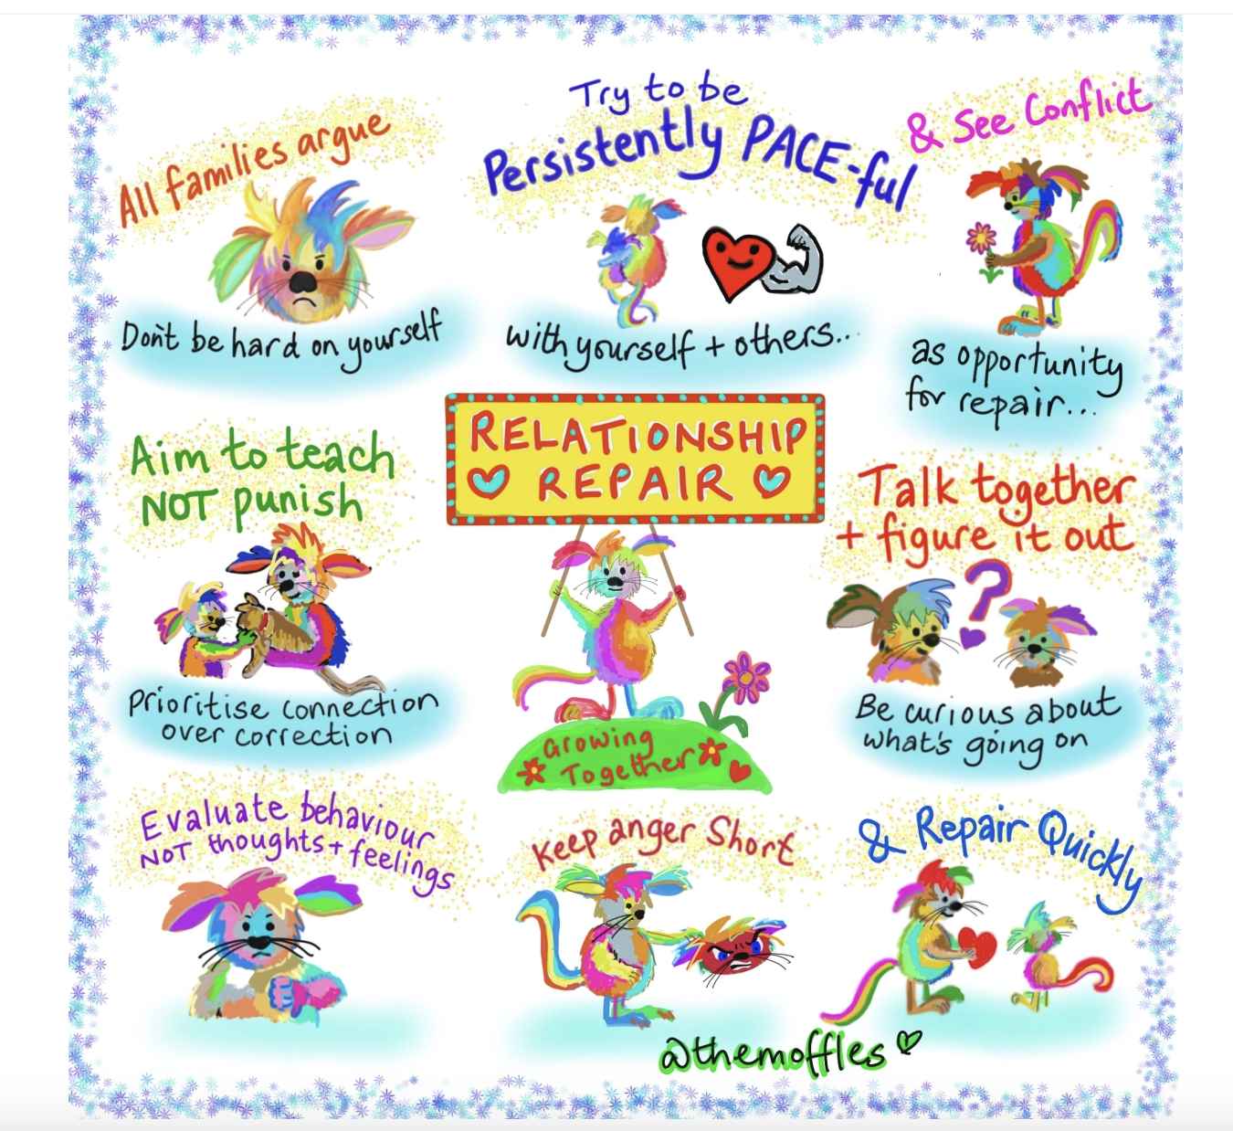
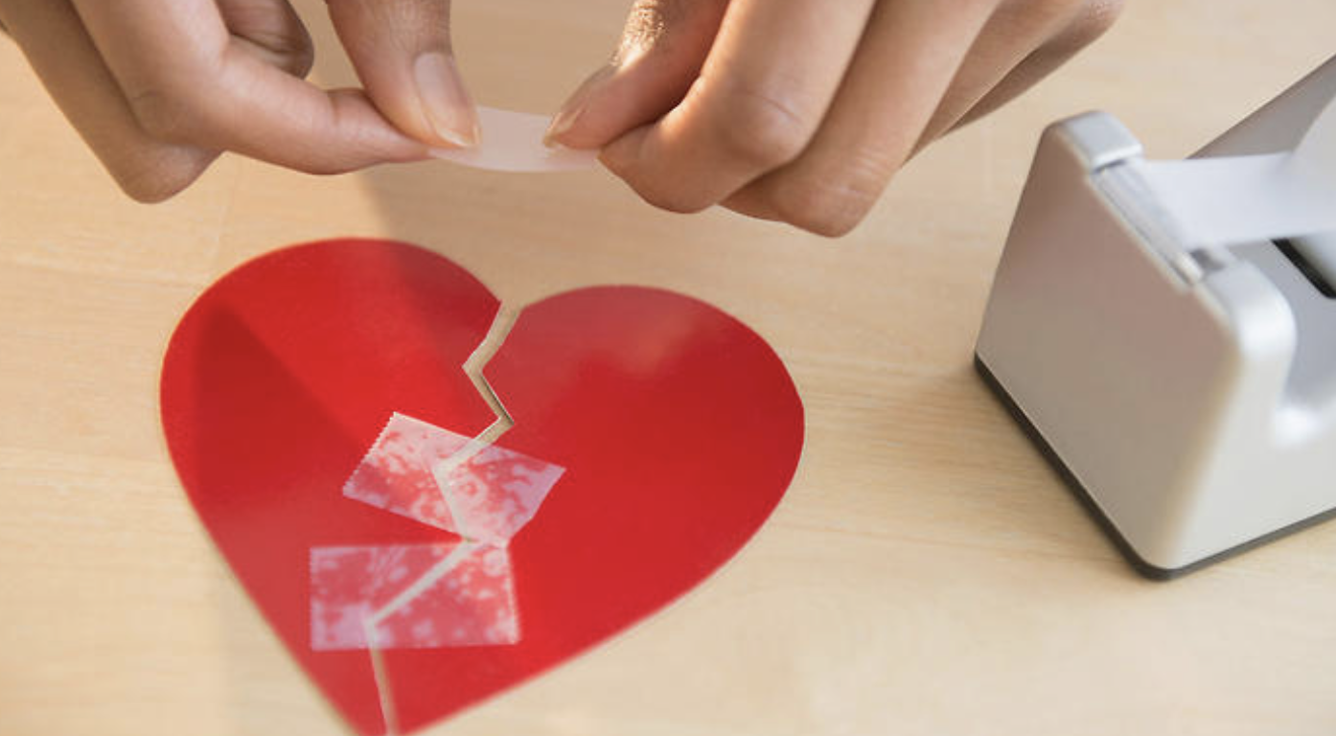
Relationship Repair
Reconnect
Reflect (not lecture)
Repair

Slide 40
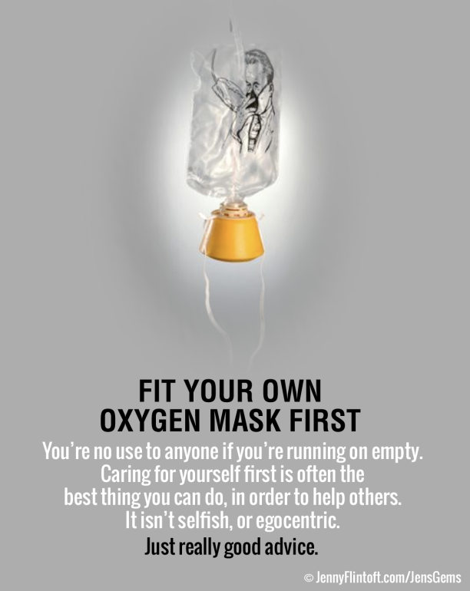
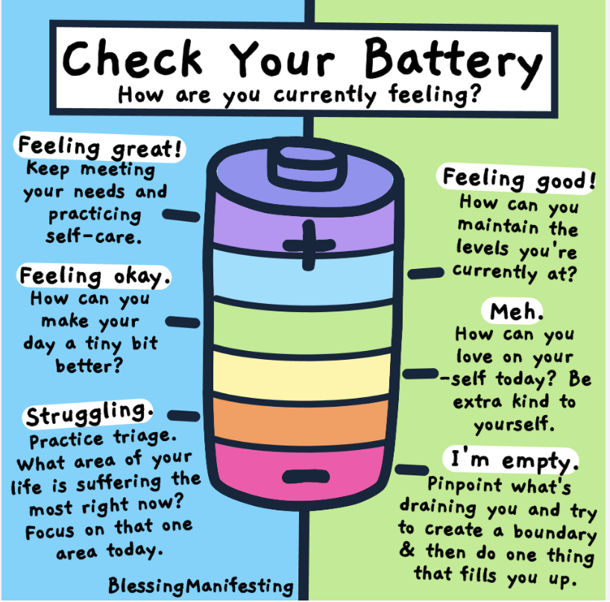
The Importance of Self-Care

Slide 41

Reflection
Your relationship is a key part of the intervention.
What is one small shift you commit to making this week?

Slide 42
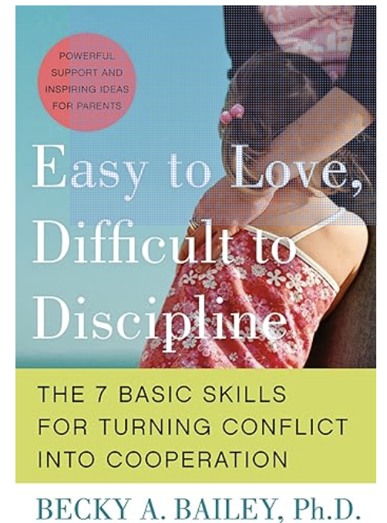
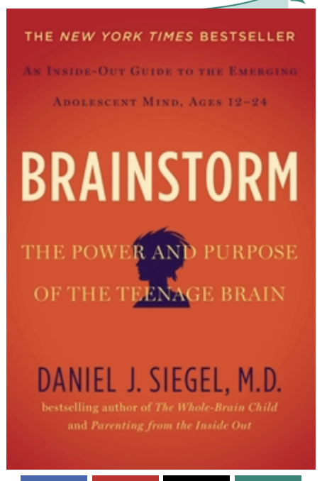



Resources
For questions or follow-up: Sladden@behavioralpediatricinstitute.com or 205-414-6686.

